Slide 1


The Bonch-Bruevich St.-Petersburg State University of Telecommunications
ITU/ML Challenge
“Applying machine learning in Communication networks”
Proposal to open the new Problem statement
“Traffic recognition and Long-term traffic forecasting based on
AI algorithms and metadata for 5G/IMT-2020 and beyond”
Speaker
Artem Volkov, PhD Student of SPbSUT, Russia
Team
1.Artem Volkov
2.Ali Refaee Abdellah mohamed
2020, Russian Federation

Slide 2
Agenda
Common Background
Gap Analysis of current problem statements* (which nearly related with the proposal)
Proposal for the new problem statement
Proposal for the new problem statement. Key Features
Proposal for the new problem statement. Directions
Research Background. SDNLab Infrastructure
Research Background. Direction 1 - Traffic recognition
Research Background. Direction 1 - Traffic recognition. Results
Research Background. Direction 1/ Direction 2
Task. Output Format

Slide 3
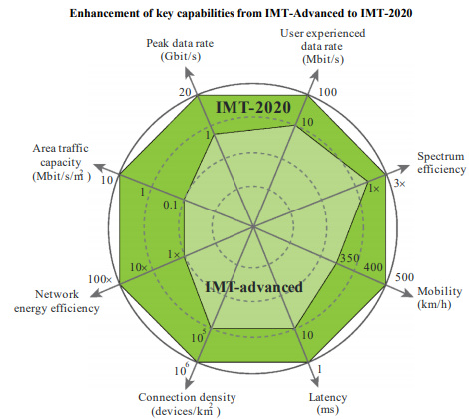
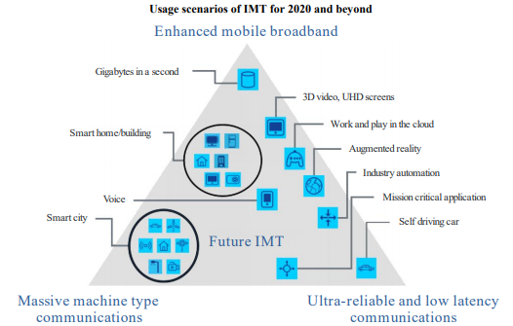
Common Background
Fig. 1*
Fig. 2*
* - Reference to ITU-R 2083-0 (09/2015) “IMT Vision – Framework and overall objectives of the future development of IMT for 2020 and beyond “

Slide 4
Gap Analysis of current problem statements*
(which nearly related with the proposal)
Problem Statement | Id | Title | Status (restricted/open) | Analysis results
1 | ITU-ML5G-PS-014 | Graph Neural Networking Challenge 2020 | open | The question with traffic recognition is not included in this problem statement. In addition, the data set isn't based on the metadata approach. And also the Long-term forecasting it’s not includes in this problem statement.
2 | ITU-ML5G-PS-016 | Radio network Traffic Prediction | Restricted | In this case, the authors propose to use data from the DPI system, which have a deep knowledge of traffics and also this approach goal on post-factum traffic prediction. In addition, this proposal is directed to Radio network traffic researching (base station). And also the Long-term forecasting it’s not includes in this problem statement.
3 | ITU-ML5G-PS-017 | User-Specific Demand Prediction | open | In this case, the current research problem is goaled on the prediction of time-varying requesting probability of each user requesting each content item in the next 24 hours in mobile network. It’s not include question of traffic recognition. And also the Long-term forecasting it’s not includes in this problem statement.
* Reference to “A compilation of problem statements and resources for ITU Global Challenge on AI/ML in 5G networks (formerly ML5G-I-223)”

Slide 5
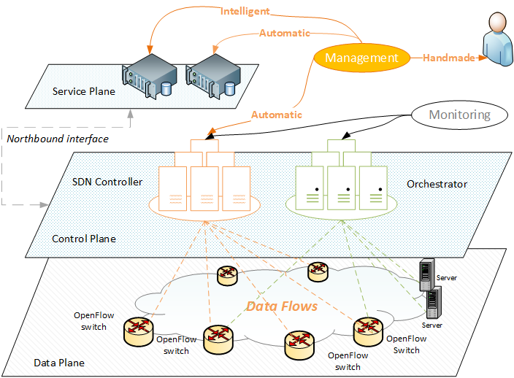
Proposal for the new problem statement
Traffic identification on the Data Plane is required for Intelligent and Automatic management
De-facto requirements
SaaS approach
Independence from the vendor’s solutions (open API);
OpenSource platforms;
Fig. 3

Slide 6
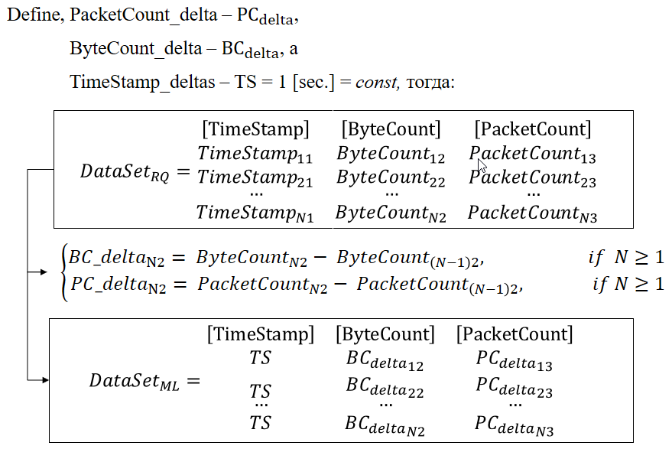
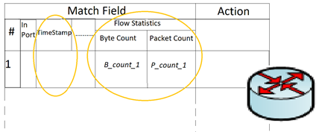
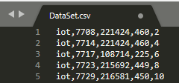
Proposal for the new problem statement. Key Features
Fig.4 - Flow Table (ver. Openflow 1.0)
Fig.5 - Example of Marked Data Sets
Key features:
Metadata, Long-term forecasting
Notes:
Taking into account

Slide 7
Proposal for the new problem statement. Directions
Direction 1: AI for traffic recognition and classification*
Using the Metadata of flows for making the models of each of traffic based on Machine Learning
Direction 2: AI for Long-term traffic forecasting*
Using the Metadata of recognited flows for making long-term traffic forecasting. This direction includes:
Long-term traffic forecasting on the Data Plane/User plane;
Long-term SDN loads forecasting based on analysis of OpenFlow flows on the control Plane;
Long-term infrastructure forecasting based on integrated compute resource forecasting and related traffic flows
The key features of the proposal is to use the metadata of flows on the data plane at the same time the analytical application with AI/ML algorithms is located on the service level and working with the SDN/NFV network via northbound API.
* Reference to the 6.2.1 and 6.2.2 clauses were taken from the following document “ITU AI/ML in 5G Challenge - Participation guidelines”]
Notes:
Taking into account

Slide 8
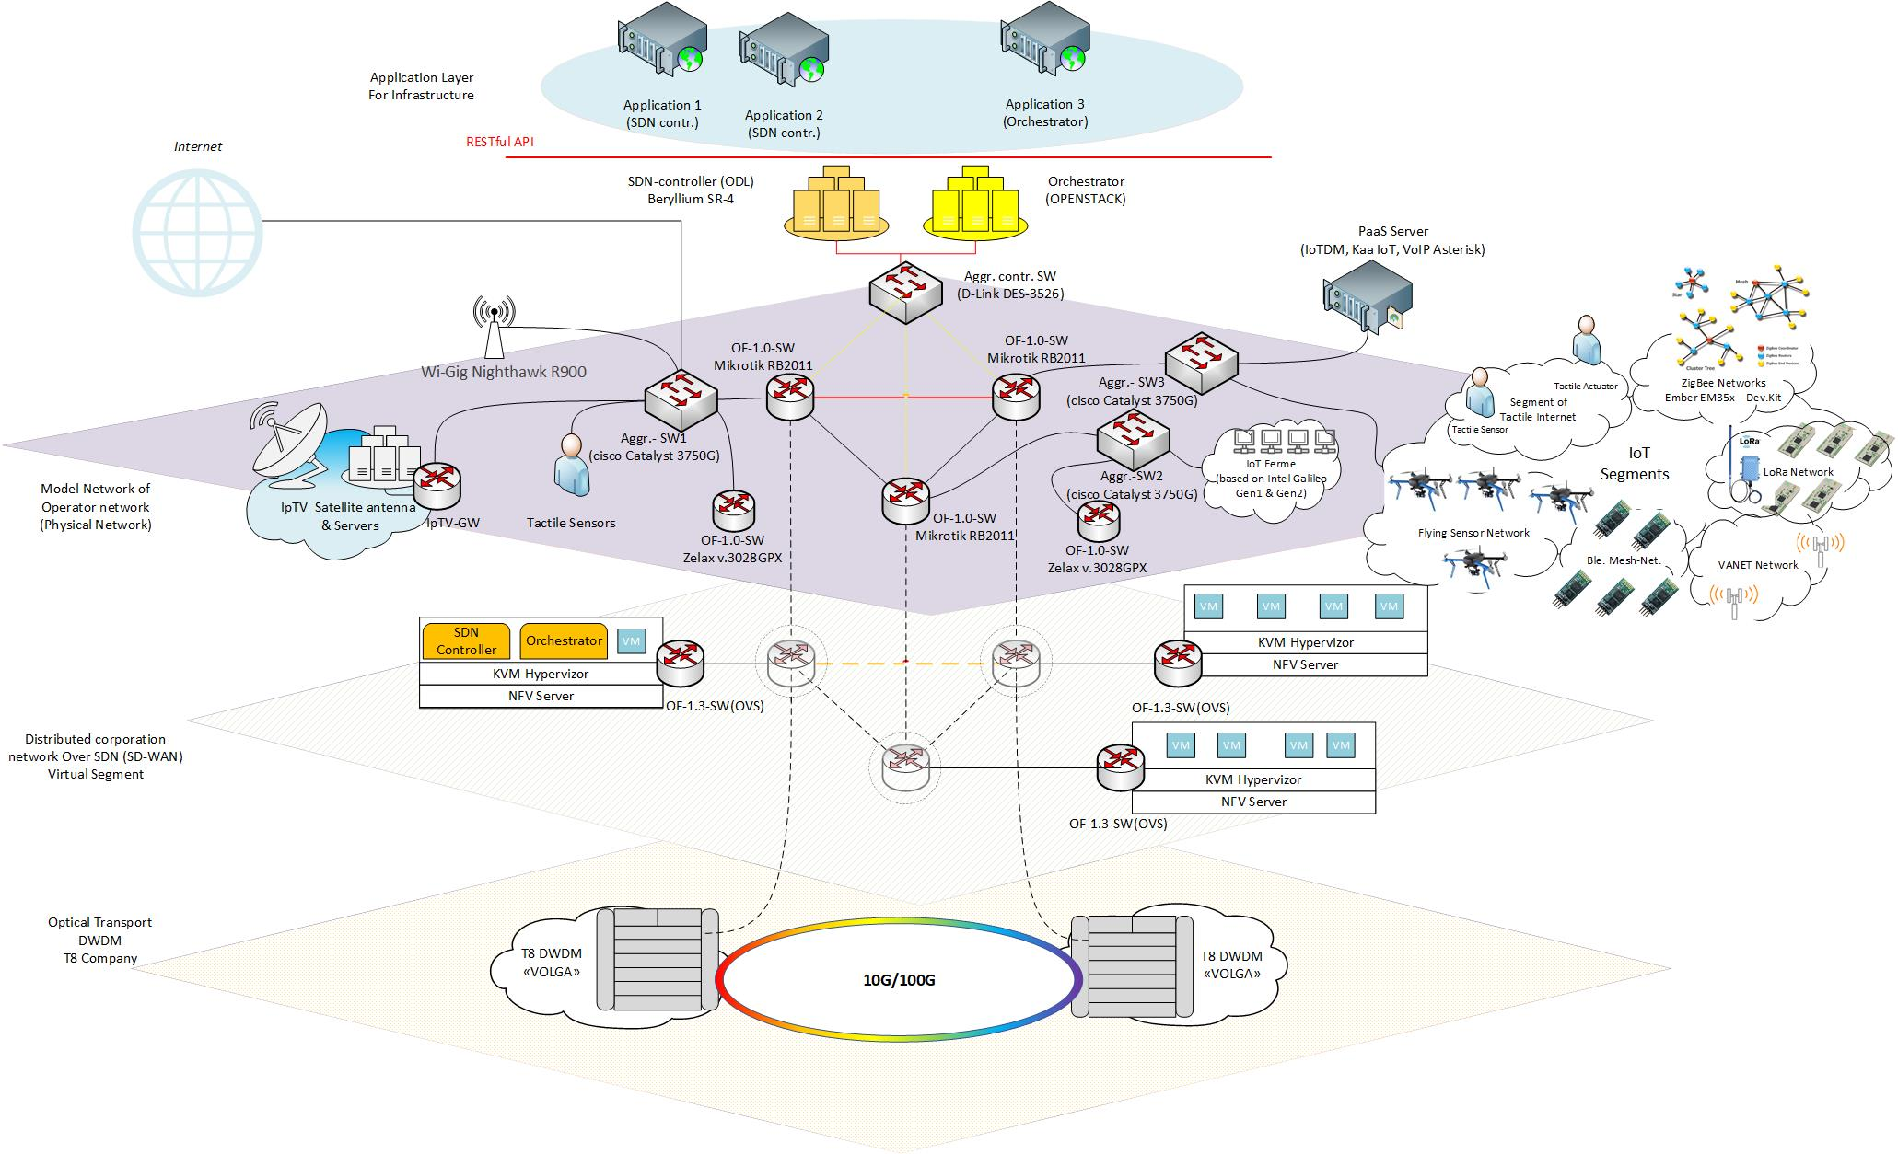
Research Background. SDNLab Infrastructure
Notes:
Taking into account

Slide 9
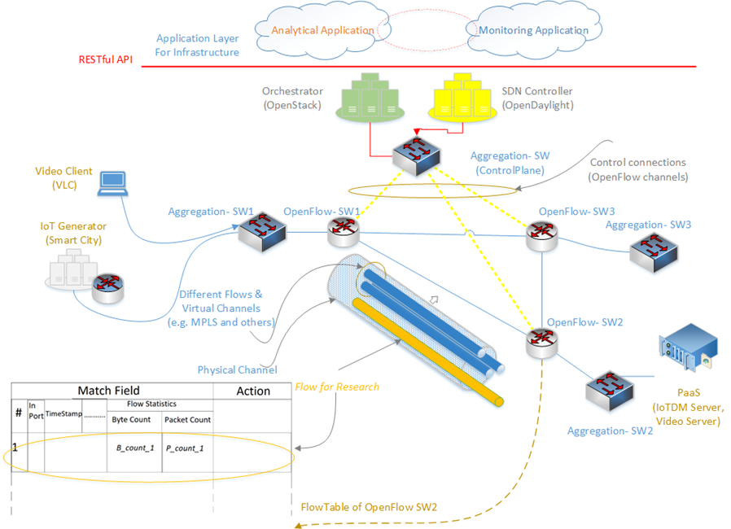
Research Background. Direction 1 - Traffic recognition
*Reference: Volkov, A., Ateya, A. A., Muthanna, A., Koucheryavy, A. (2019). Novel AI-Based Scheme for Traffic Detection and Recognition in 5G Based Networks. In Lecture Notes in Computer Science (including subseries Lecture Notes in Artificial Intelligence and Lecture Notes in Bioinformatics) (Vol. 11660 LNCS, pp. 243{255). Springer Verlag. https://doi.org/10.1007/978-3-030-30859-921.
Notes:
Taking into account

Slide 10
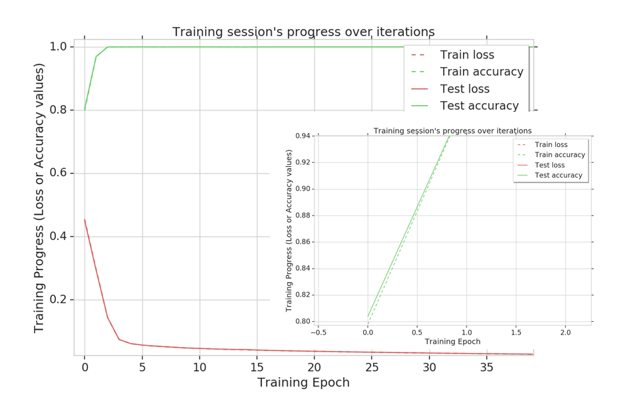
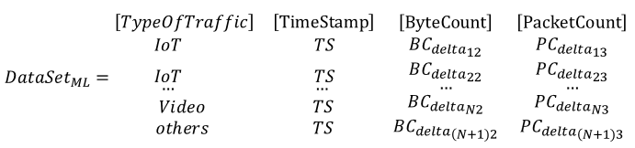
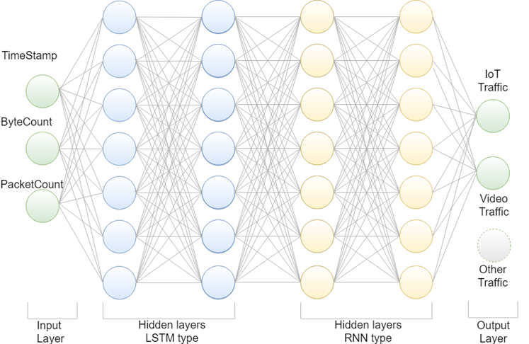
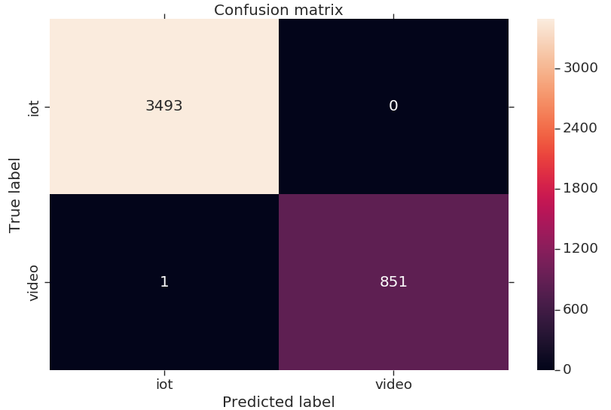
Research Background. Direction 1 - Traffic recognition. Results
*Reference: Volkov, A., Ateya, A. A., Muthanna, A., Koucheryavy, A. (2019). Novel AI-Based Scheme for Traffic Detection and Recognition in 5G Based Networks. In Lecture Notes in Computer Science (including subseries Lecture Notes in Artificial Intelligence and Lecture Notes in Bioinformatics) (Vol. 11660 LNCS, pp. 243{255). Springer Verlag. https://doi.org/10.1007/978-3-030-30859-921.
Notes:
Taking into account

Slide 11
Research Background. Direction 1/ Direction 2
Volkov, A., Ateya, A. A., Muthanna, A., Koucheryavy, A. (2019). Novel AI-Based Scheme for Traffic Detection and Recognition in 5G Based Networks. In Lecture Notes in Computer Science (including subseries Lecture Notes in Artificial Intelligence and Lecture Notes in Bioinformatics) (Vol. 11660 LNCS, pp. 243{255). Springer Verlag. https://doi.org/10.1007/978-3-030-30859-921.
Volkov, A., Proshutinskiy, K., Adam, A. B. M., Ateya, A. A., Muthanna, A., Koucheryavy, A. (2019). SDN Load Prediction Algorithm Based on Artificial Intelligence. In Communications in Computer and Information Science (Vol. 1141 CCIS, pp. 27{40). Springer. https://doi.org/10.1007/978-3-030-36625-43
Ali R. Abdellah, Omar Abdul Kareem Mahmood, Alexander Paramonov, Andrey Koucheryavy, “IoT traffic prediction using multi-step ahead prediction with neural network”, IEEE 11th International Congress on Ultra-Modern Telecommunications and Control Systems and Workshops (ICUMT), 2019. https://doi.org/10.1109/ICUMT48472.2019.8970675 .
Ali R. Abdellah , Artem Volkov , Ammar Muthanna , Andrey Koucheryavy. Deep Learning for IoT Traffic Prediction based on Edge Computing. 23rd International Conference on Distributed Computer and Communication Network 2020. [Accepted. Publishing in process]
Artem Volkov , Ali R. Abdellah , Ammar Muthanna , Andrey Koucheryavy. IoT traffic prediction with Neural networks learning based on SDN infrastructure. 23rd International Conference on Distributed Computer and Communication Network 2020. [Accepted. Publishing in process]
Notes:
Taking into account

Slide 12
Thank you for your attention!
Notes:
Taking into account

